Slide 1
Module E- Standard Libraries
Input and Validation
Formatted Output
Library Functions
Module-E- Libraries
1/49

Slide 2
Input and Validation
Types of Input
getchar
scanf
Validation
In-Class Practice
Module-E- Libraries
<number>/49

Slide 3
Types of Input
Input to a program may be unbuffered or buffered
Interactive program uses unbuffered input. The program can respond to each and every keystroke directly.
Buffered input enables data editing before submission to a program. That is, the program accepts one complete input record at a time rather than one keystroke at a time.
A buffer is a region of memory that collects and holds data temporarily.
Module-E- Libraries
<number>/49

Slide 4
Buffered Input
To transfer the contents of a buffer to a program the user must press the '\n' character.
Two C functions provide buffered input facilities on the standard input stream:
  getchar
  scanf
Module-E- Libraries
<number>/49

Slide 5
getchar
getchar retrieves a single character from the standard input stream buffer without translating the input.
  int getchar ( void );
getchar returns either the character code for the retrieved character or EOF.
(EOF=-1, ctrl+z in Windows, ctrl+d in Unix)
Module-E- Libraries
<number>/49

Slide 6
Clearing the buffer
/* clear empties input buffer */
void clear (void) {
  while ( getchar() != '\n' )
  ;/* null statement intentional */
}
Module-E- Libraries
<number>/49

Slide 7
Formatted input: scanf (1)
int scanf(const char *format, arg-list)
The prototype for scanf( ) is in <stdio.h>. The scanf( ) function is a general-purpose input routine that reads the stream stdin. It can read all the built-in data types and automatically convert them into the proper internal format. It is much like the reverse of printf( ).
The control string pointed to by format consists of three types of characters:
  - Format specifiers
  - White-space characters
  - Non-white-space characters
The format specifiers are preceded by a percent sign and tell scanf( ) what type of data is to be read next. For example, %s reads a string while %d reads an integer.
Module-E- Libraries
<number>/49

Slide 8
scanf (2)
The format string is read left to right, and the format codes are matched, in order, with the arguments that make up the argument list.
A white-space character in the control string causes scanf( ) to skip over one or more white-space characters in the input stream. A white-space character is either a space, a tab, or a newline. In essence, one white-space character in the control string causes scanf( ) to read, but not store, any number (including zero) of white-space characters up to the first non-white-space character.
A non-white-space character causes scanf( ) to read and discard a matching character. For example, "%d,%d" causes scanf( ) to read an integer, read and discard a comma, and then read another integer. If the specified character is not found, scanf( )
terminates.
Module-E- Libraries
<number>/49

Slide 9
scanf (3)
All the variables used to receive values through scanf( ) must be passed by their addresses. This means that all arguments must be pointers to the variables used as arguments. This is C’s way of creating a call by reference, and it allows a function to alter the contents of an argument. For example, to read an integer into the variable count, you would use the following scanf( ) call:
scanf("%d", &count);
Strings are read into character arrays, and the array name, without any index, is the address of the first element of the array. So, to read a string into the character array address, use
scanf("%s", address);
In this case, address is already a pointer and need not be preceded by the & operator.
Module-E- Libraries
<number>/49

Slide 10
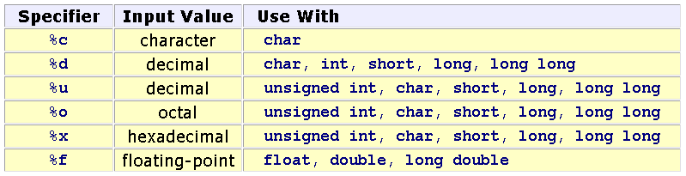
scanf (4)
Conversion Specifiers
Module-E- Libraries
<number>/49

Slide 11
scanf (5) - Conversion Specifiers
Code Meaning
%c Read a single character
%d Read a decimal integer
%D Read a long integer (C++ Builder specific)
%i Read a decimal integer
%I Read a long integer (C++ Builder specific)
%e Read a floating-point number
%E Read a floating-point number
%f Read a floating-point number
%g Read a floating-point number
%G Read a floating-point number
%o Read an octal number
%O Read an long octal number (C++ Builder specific)
%s Read a string
%x Read a hexadecimal number
%X Read a hexadecimal number
%p Read a pointer
%n Receives an integer value equal to the number of characters read so far
%u Read an unsigned integer
%U Read an unsigned long integer (C++ Builder specific)
%[ ] Scan for a set of characters
%% Read a % sign
scanf("%[ABC]",str); //only the characters A, B, and C
scanf("%[A-F]",str);//accept the letters 'A' through 'F‘
scanf("%[^\n]",str);//read until encountering the '\n' character
Module-E- Libraries
<number>/49

Slide 12
scanf (6)
scanf treats the whitespace between the input values as a separator
  int items; float price;
  printf("Enter items, price : ");
  scanf("%d%f", &items, &price);
Enter items, price: 3 5.2
Module-E- Libraries
<number>/49

Slide 13
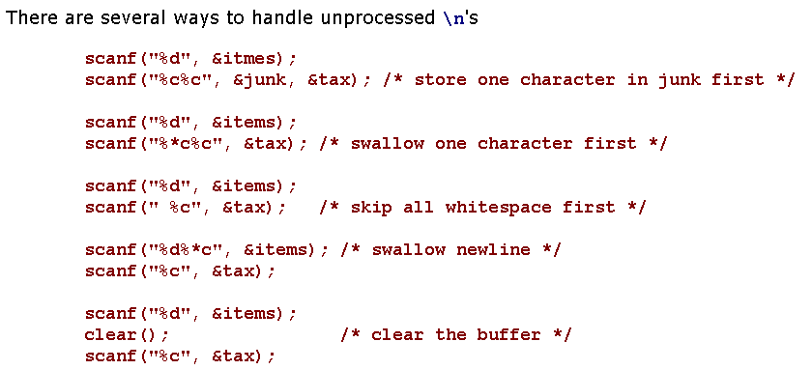
scanf (7)
Module-E- Libraries
<number>/49

Slide 14
scanf (8)
Return Values
  scanf returns the number of addresses successfully filled or EOF. A return value of
    0 indicates that scanf did not fill any address,
    1 indicates that scanf filled the first address successfully,
    2 indicates that scanf filled the first and second addresses successfully,
    ...
    EOF indicates that scanf did not fill any address AND encountered an end of data character.
The return code from scanf does not reflect success of %* conversions
Module-E- Libraries
<number>/49

Slide 15
Validation
We cannot predict how the user will input the data values: whether the user will enter them as requested or not. One user may make a mistake. Another user may simply try to break the program.
We write the program so that it traps all erroneous input, which includes:
  invalid characters
  trailing characters
  out-of-range input
  incorrect number of input fields
Module-E- Libraries
<number>/49

Slide 16
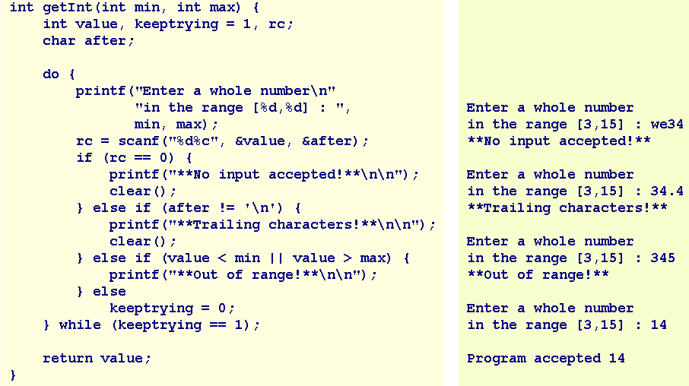
Validation example
Module-E- Libraries
<number>/49

Slide 17
In-Class Practice
Design and code a function named getDouble that receives two double values - a lower limit and an upper limit - and returns user input that lies between the limiting values. Your function rejects any input that includes trailing characters or lies outside the specified limits.
Module-E- Libraries
<number>/49

Slide 18
Summary
Input and Validation
Types of Input
getchar
scanf
Validation
In-Class Practice
Q&A
Module-E- Libraries
<number>/49

Slide 19
Output
putchar
printf
Module-E- Libraries
<number>/49

Slide 20
putchar
putchar writes the character received to the standard output stream buffer and returns the character written or EOF if an error occurred.
Prototype:
  int putchar ( int );
For example:
  putchar('a');
Module-E- Libraries
<number>/49

Slide 21
Formatted output: printf
printf sends data under format control to the standard output stream buffer and returns the number of characters sent.
Syntax
printf ( format string , value, ..., value )
The format string is a literal string that consists of characters interspersed with conversion specifiers.
Conversion specifier begins with a % and ends with a conversion character
Module-E- Libraries
<number>/49

Slide 22
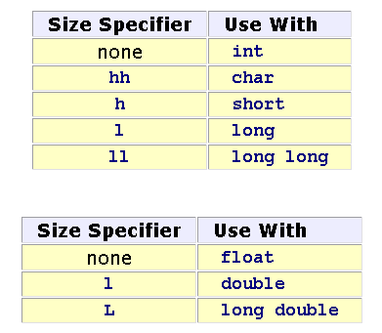
Format string
Between the % and the conversion character, there may be
% flags width . precision size conversion_character
flags
  - prescribes left justification of the converted value in its field
  0 pads the field width with leading zeros
size identifies the size of data type of the value passed.
Module-E- Libraries
<number>/49

Slide 23
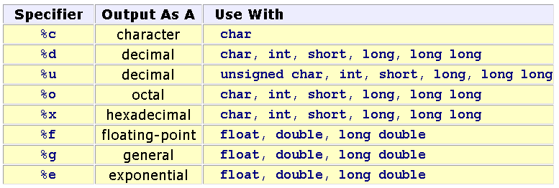
Conversion Specifiers
Module-E- Libraries
<number>/49

Slide 24
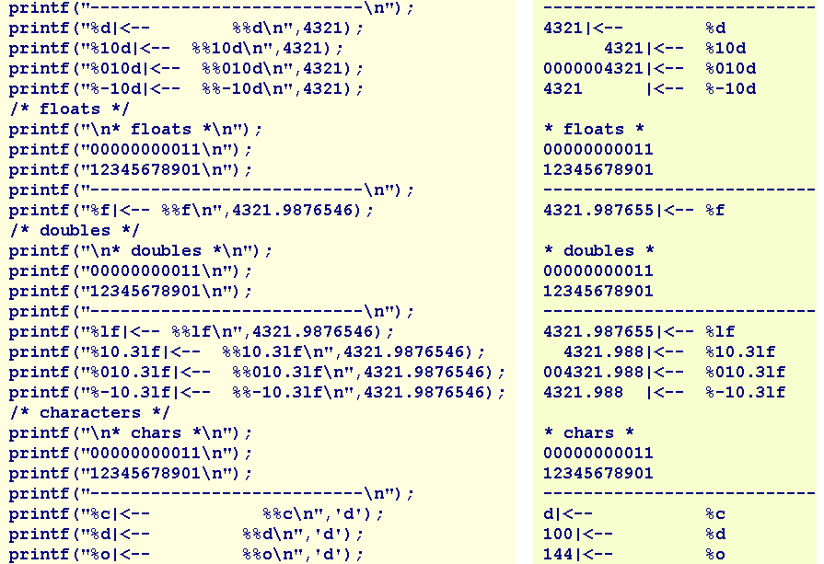
Module-E- Libraries
<number>/49

Slide 25
Summary
Formatted Output
putchar
printf
Q&A
Module-E- Libraries
<number>/49

Slide 26
Library Functions
The standard C libraries include functions to perform mathematical calculations, character analysis and character manipulation.
Module-E- Libraries
<number>/49

Slide 27
Session Objectives
The standard C libraries
Standard
Time
In-Class Practice
Math
Character
Module-E- Libraries
<number>/49

Slide 28
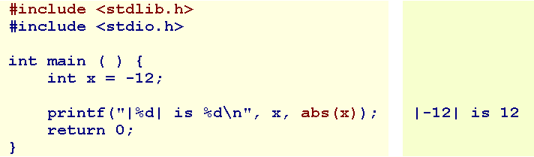
Standard (1)
The prototypes for the more popular standard functions are in <stdlib.h>.
Integer Absolute Value
    int abs ( int );
    long labs ( long );
Module-E- Libraries
<number>/49

Slide 29
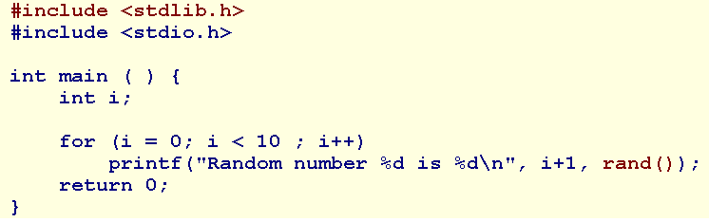
Standard (2)
Random Number
rand returns a pseudo-random integer in the range 0 to RAND_MAX. RAND_MAX is implementation dependent but at least 32767.
  int rand ( void );
For example, the following program outputs the same results every run:
Module-E- Libraries
<number>/49

Slide 30
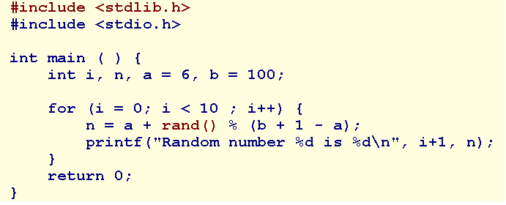
Standard (3)
The following program prints 10 pseudo-random integers between 6 and 100 inclusive:
Module-E- Libraries
<number>/49

Slide 31
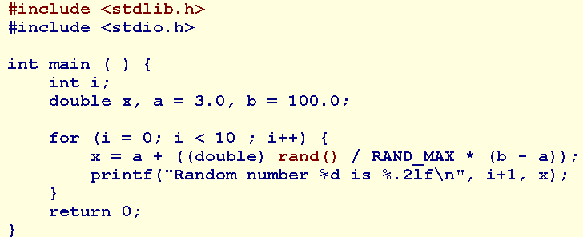
Standard (4)
The following program prints 10 pseudo-random floating-point numbers between 3.0 and 100.0 inclusive:
Module-E- Libraries
<number>/49

Slide 32
Standard (5)
Random Number Seed
  srand sets the seed for the random number generator.
  int srand ( unsigned int seed );
  We call srand before the first call to rand, typically at the start of our program. We use time(NULL) to generate a unique time-based seed for each new run.
Module-E- Libraries
<number>/49

Slide 33
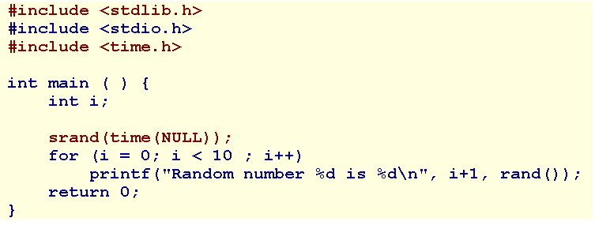
Standard-5
The following program outputs a different set of random numbers with every run:
The prototype for time is in <time.h>
Module-E- Libraries
<number>/49

Slide 34
Time (1)
The prototypes for the time library functions are in <time.h>.
time returns the current calendar time. The prototype is
  time_t time ( time_t *tptr );
  time_t is a type that it is sufficiently large to hold time values (for example, unsigned long).
  time also assigns the current calendar time to *tptr, if tptr is not NULL.
  If an error occurs, time returns the value (time_t)(-1).
Module-E- Libraries
<number>/49

Slide 35
time (2)
difftime
difftime returns the difference in seconds between two calendar time arguments.
  double difftime ( time_t, time_t );
  time_t is a type that it is sufficiently large to hold time values (for example, unsigned long).
Module-E- Libraries
<number>/49

Slide 36
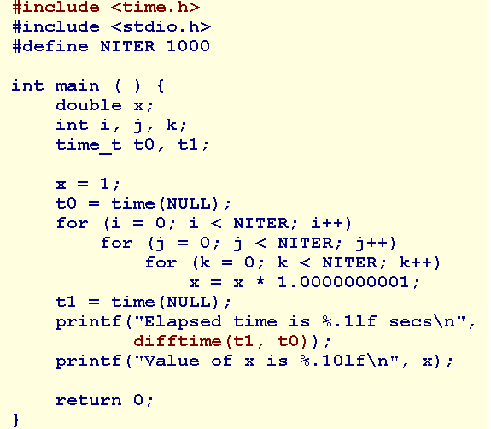
time (3)
Module-E- Libraries
<number>/49

Slide 37
clock (1)
clock returns the approximate process time. The prototype is
  clock_t clock ( void );
clock_t is a type that holds time values (for example, unsigned long). We divide the time value by CLOCKS_PER_SEC to obtain the process time in seconds.
Module-E- Libraries
<number>/49

Slide 38
#include <time.h>
#include <stdio.h>
int main() {
clock_t start_t, end_t, total_t;
int i;
start_t = clock();
printf("Bat dau chuong trinh, start_t = %ld\n", start_t); printf("Quet qua mot vong lap lon, start_t = %ld\n", start_t);
for(i=0; i< 10000000; i++) { }
end_t = clock();
printf("Ket thuc vong lap, end_t = %ld\n", end_t);
total_t = (double)(end_t - start_t) / CLOCKS_PER_SEC; printf("Tong thoi gian su dung boi CPU: %f\n", total_t ); printf("Thoat chuong trinh ...\n"); r
eturn(0); }
Module-E- Libraries
<number>/49

Slide 39
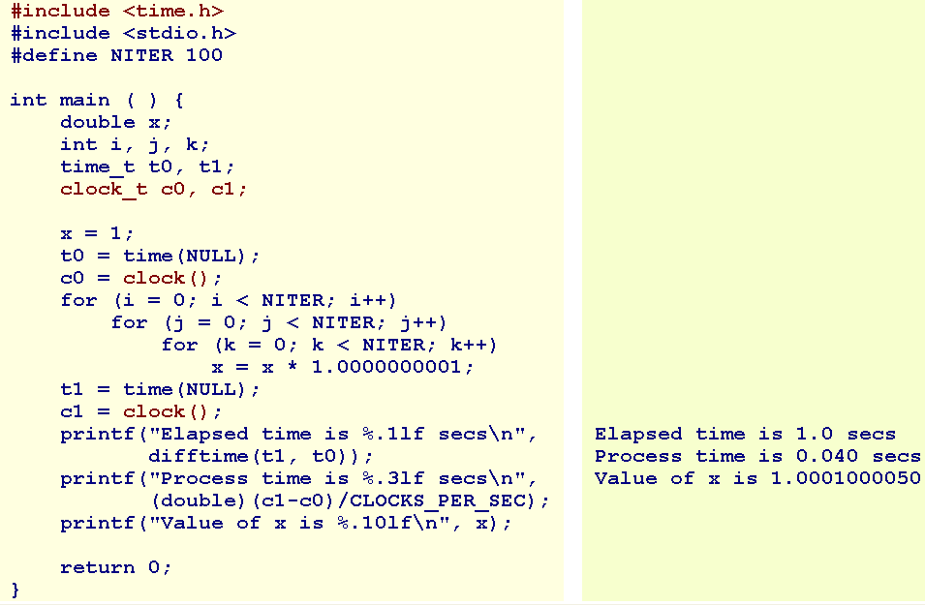
clock (2)
Module-E- Libraries
<number>/49

Slide 40
In-Class Practice
Design and code a program named coinToss.cpp that
  prompts the user for the number of times to toss a coin,
  accepts a positive value as the number of times,
  simulates the coin tosses for the requested number of times, and
  reports the percentage of head results and the percentge of tail results for the coin tosses.
Module-E- Libraries
<number>/49

Slide 41
Math (1)
The prototypes for the math functions are in <math.h>.
Floating-Point Absolute Value
fabs, fabsf returns the absolute value of the floating-point value received. Their prototypes are
  double fabs ( double );
  float fabsf ( float );
Module-E- Libraries
<number>/49

Slide 42
Math (2)
floor
floor, floorf return the largest integer value not greater than the value received. Their prototypes are
  double floor ( double );
  float floorf ( float );
For example, floor(16.3) has a value of 16.0.
Module-E- Libraries
<number>/49

Slide 43
Math (3)
Ceiling
ceil, ceilf return the smallest integer value not less than the value received. Their prototypes are
  double ceil ( double );
  float ceilf ( float );
For example, ceil(16.3) has a value of 17.0.
Module-E- Libraries
<number>/49

Slide 44
Math (4)
Rounding
round, roundf return the integer value closest to the value received. Their prototypes are
  double round ( double );
  float roundf ( float );
For example, round(16.3) has a value of 16.0, while round(-16.3) has a value of -16.0.
Module-E- Libraries
<number>/49

Slide 45
Math (5)
Truncating
trunc, truncf, truncl return the integer component of the value received. Their prototypes are
  double trunc ( double );
  float truncf ( float );
  long double truncl ( long double );
For example, trunc(16.7) has a value of 16.0, while round(16.7) has a value of 17.0.
Module-E- Libraries
<number>/49

Slide 46
Math (6)
Square Root
sqrt, sqrtf, sqrtl return the square root of the floating-point value received. Their prototypes are
  double sqrt ( double );
  float sqrtf ( float );
  long double sqrtl ( long double );
For example, sqrt(16.0) has a value of 4.0.
Module-E- Libraries
<number>/49

Slide 47
Math (7)
Powers
pow, powf, powl return the result of the first floating-point value received raised to the power of the second floating-point value. Their prototypes are
  double pow ( double base, double exponent );
  float powf ( float base, float exponent );
  long double powl ( long double base, long double exponent );
Module-E- Libraries
<number>/49

Slide 48
Math (8)
Logarithms
log, logf, logl return the natural logarithm of the floating-point value received. Their prototypes are
  double log ( double );
  float logf ( float );
  long double logl ( long double );
For example, log(2.718281828459045) has a value of 1.0.
Module-E- Libraries
<number>/49

Slide 49
Math (9)
Powers of e
exp, expf, expl return the natural anti-logarithm of the floating-point value received. Their prototypes are
  double exp ( double );
  float expf ( float );
  long double expl ( long double );
For example, exp(1.0) has a value of 2.718281828459045
Module-E- Libraries
<number>/49

Slide 50
Character (1)
The prototypes for character analysis and character manipulation functions are in <ctype.h>.
In checking for a true value, we check that the value is not false: that is, value != 0, rather than assume that true is represented by unity
Module-E- Libraries
<number>/49

Slide 51
Character (2)
int islower ( int );
int isupper ( int );
int tolower ( int );
int toupper ( int );
int isalpha ( int );
int isdigit ( int );
int isspace ( int ); (Whitespace characters are ' ', '\t', '\n', '\v', and '\f'. )
int isblank ( int ); (space or tab )
Module-E- Libraries
<number>/49

Slide 52
Summary
The standard C libraries
Standard
Time
Math
Character
Q&A
Module-E- Libraries
<number>/49

Slide 53
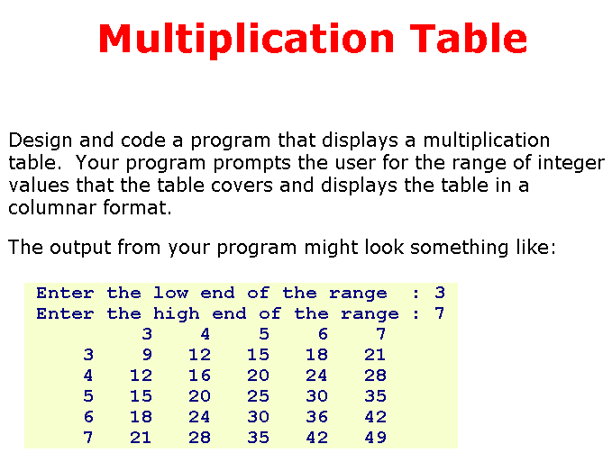
Practice
Module-E- Libraries
<number>/49

